Slide 1




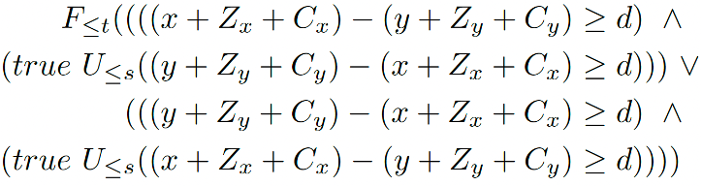
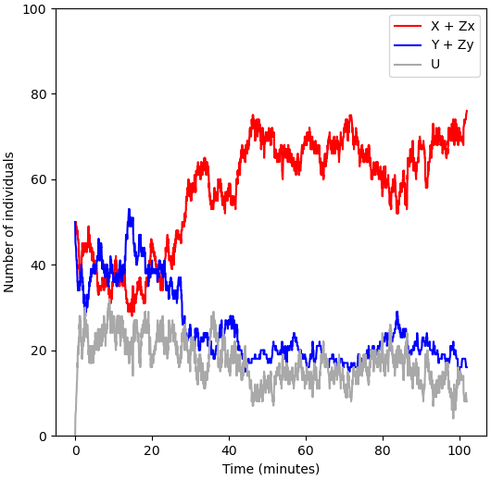
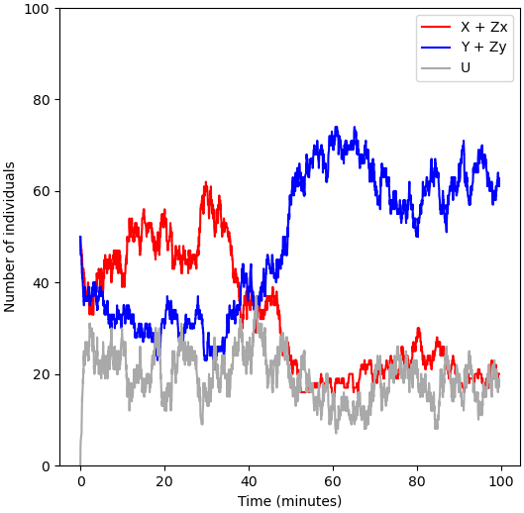
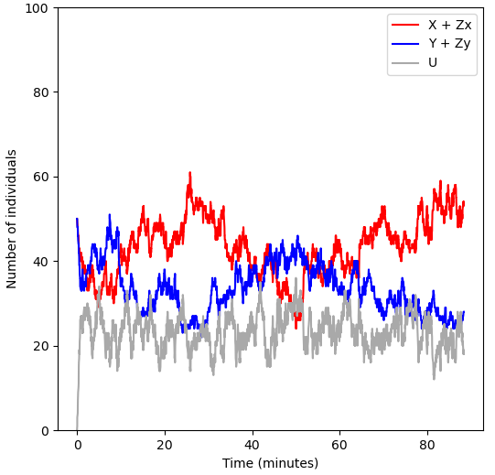
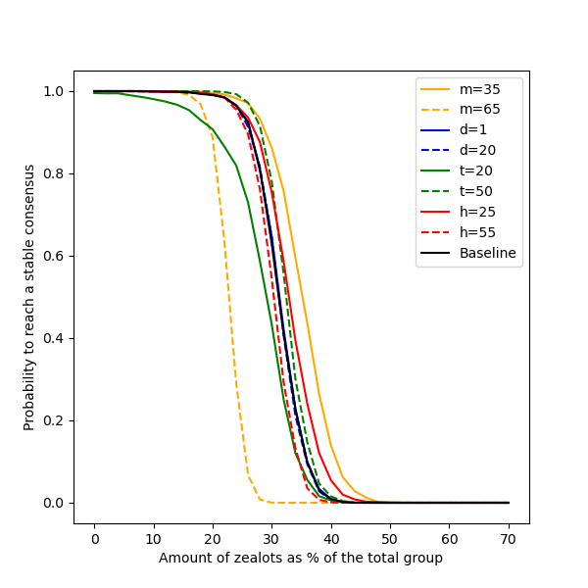
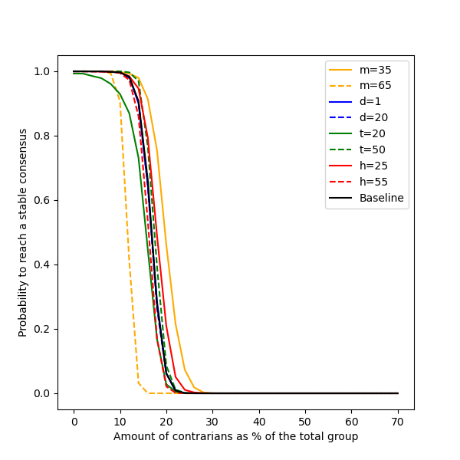
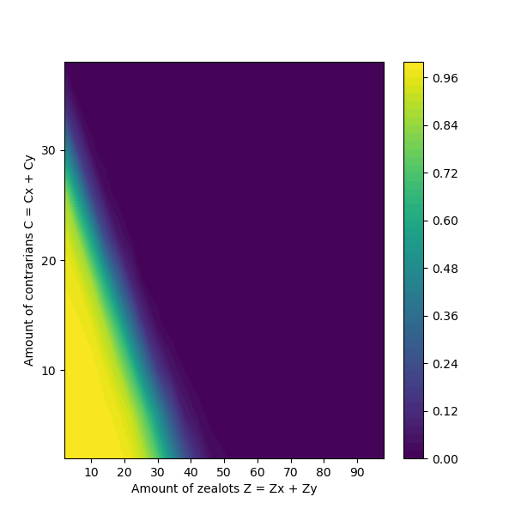
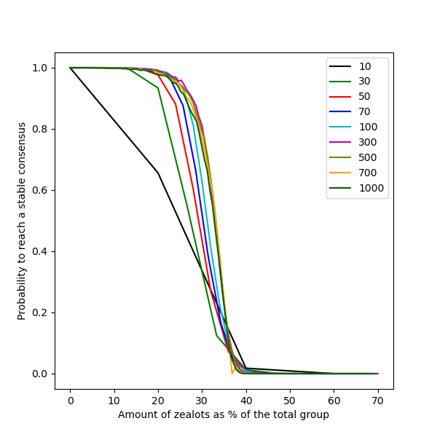
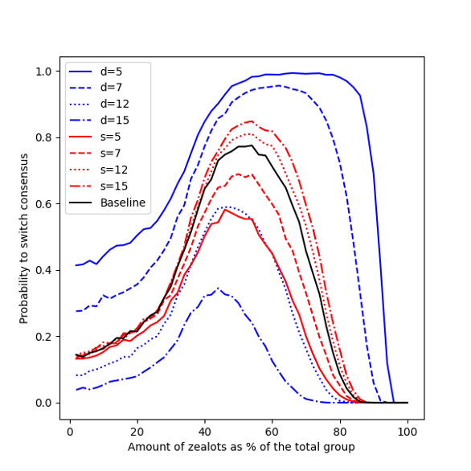
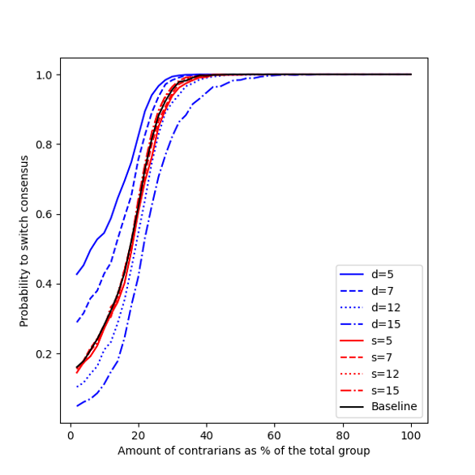
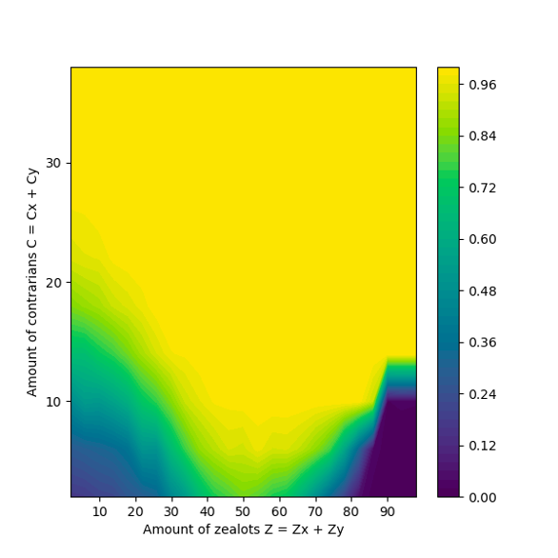
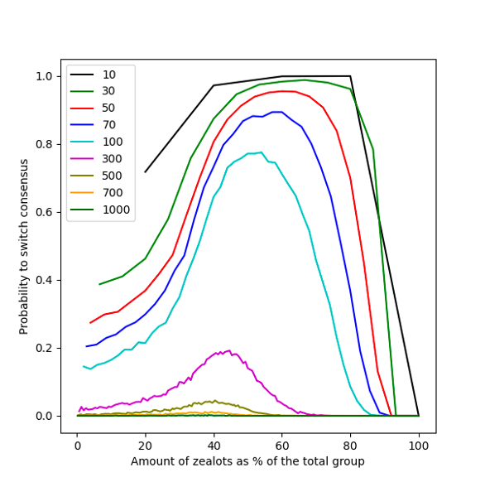
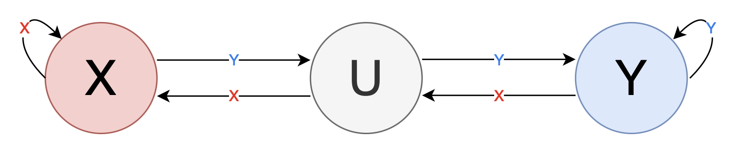
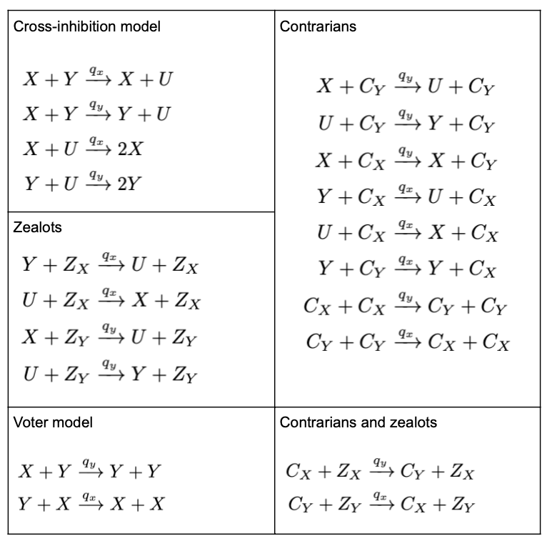
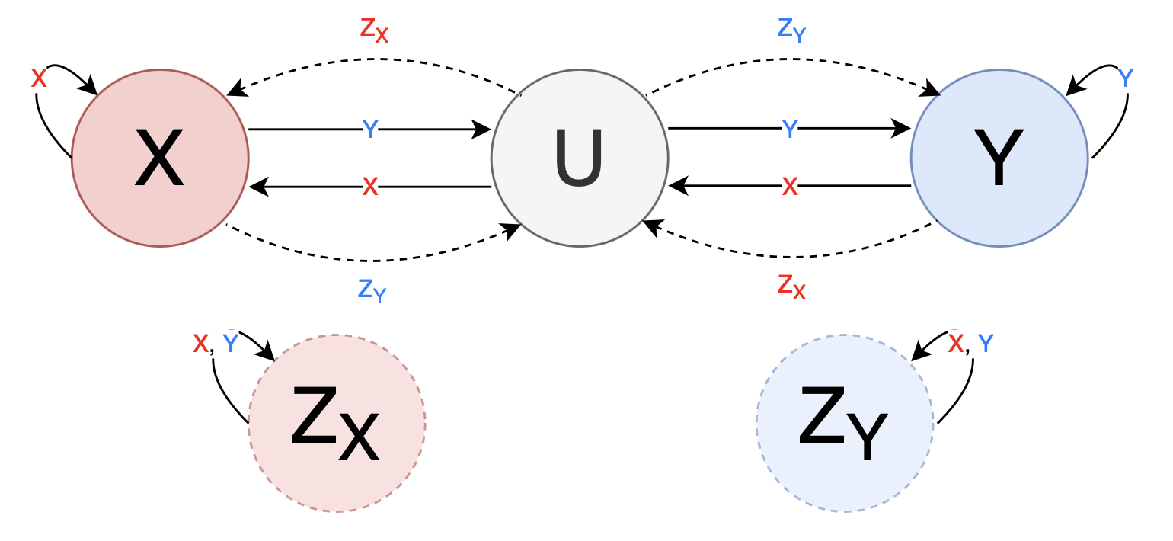
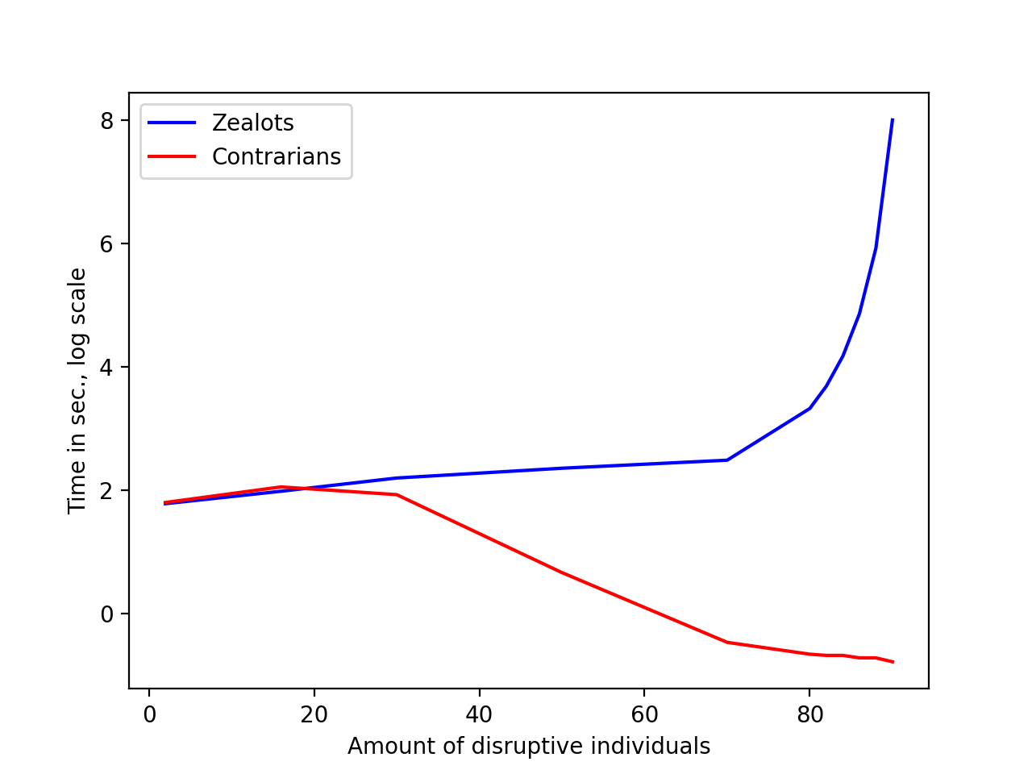
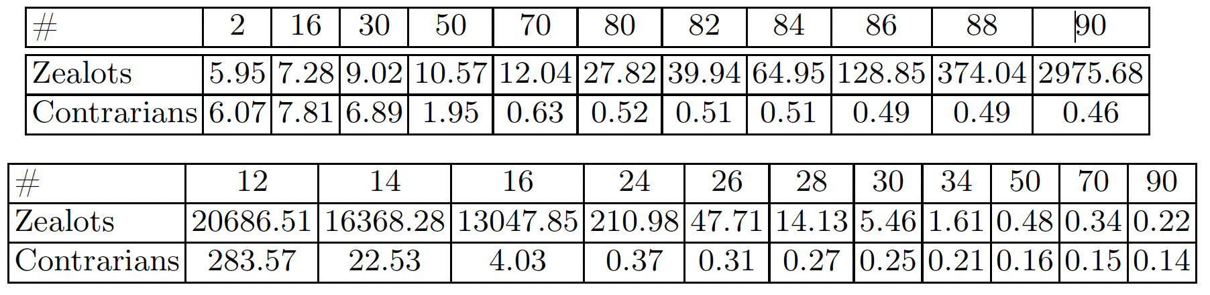
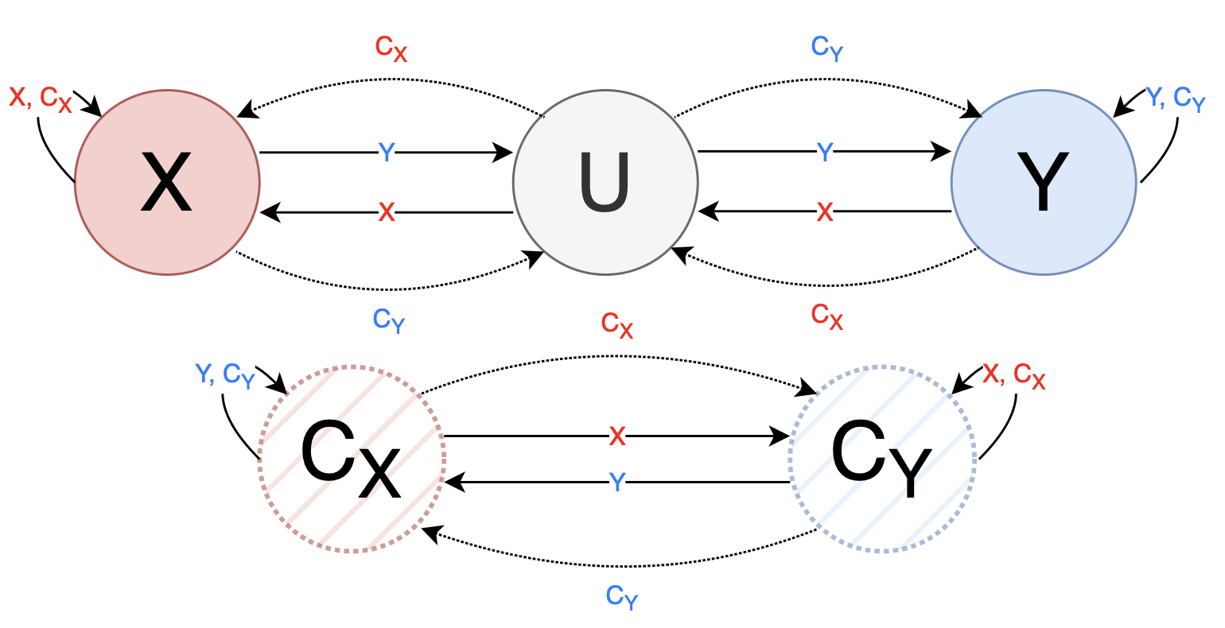
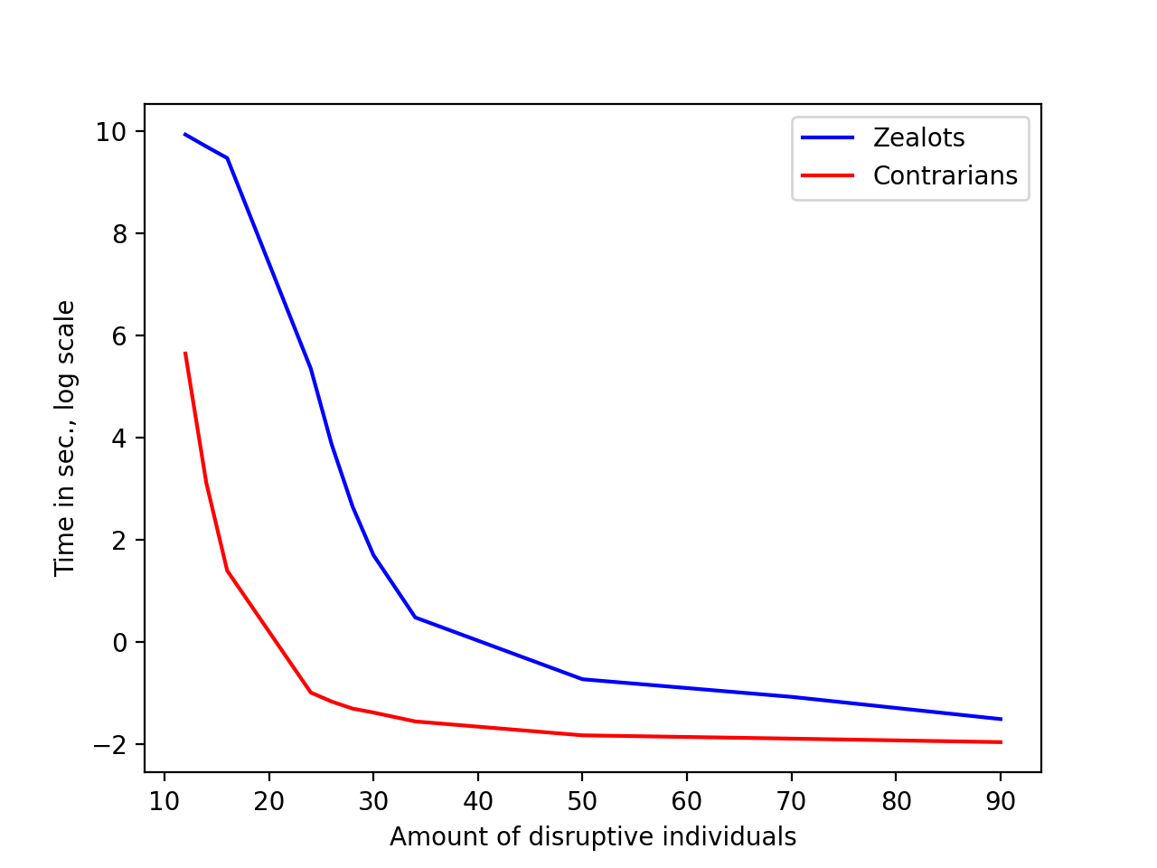

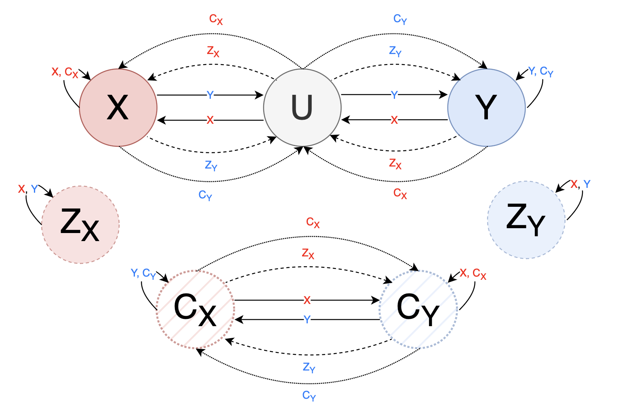
x
Exploring Consensus Robustness in Swarms
with Disruptive Individuals
Julia Klein^{1,2}, Alberto d’Onofrio³, Tatjana Petrov^{2,3,4}
¹University of Konstanz ²Centre for the Advanced Study of Collective Behaviour, University of Konstanz ³University of Trieste ⁴Max Planck Institute of Animal Behaviour, Radolfzell
julia.klein@uni-konstanz.de
Motivation
Analysis
Consensus in collective systems essential for coordinated behaviour
Strongly opinionated minorities can disrupt opinion dynamics
Approach: investigate robustness of consensus-reaching among stubborn individuals (zealots) and contrarians
Statistical model checking to formally quantify robustness under perturbations of the amount of disruptive individuals
Investigate robustness landscape for combinations of different disruptive agents
Goal: guide design and control of swarm robotics systems with focus on resilience to disruptive agents
Formally describe observed scenarios in Bounded Linear Temporal Logic
Definition of consensus with five parameters: at least majority m% of population commits to same decision, difference of at least d between both groups, consensus is reached within reaching time t, consensus is maintained for at least holding time h, switch to other opinion happens within switching time s
Baseline: m=50, d=10, t=35, h=40, s=10
Stable consensus (1a) in BLTL:
Switching consensus (1b) in BLTL:
Statistical model checking to estimate satisfaction probability and explore robustness of scenarios
Background
Underlying model of decision-making: cross-inhibition model with ‘undecided’ state between switching opinion (2a), including
zealots: never change their own opinion (2b)
contrarians: counter opinion of individual they interact with (2c)
both zealots and contrarians (2d)
Scenario:
2 equivalent options X and Y
Group of N=100 individuals
Initial state: equally split between X and Y, varying amount of disruptive individuals
Observation of 3 different group dynamics:
Results
Robustness of reaching a stable consensus (1a)
Robustness of switching consensus (1b)
Expected times
Robustness – Zealots
Robustness – Contrarians
Combined effect
Group size effect
(1a) stable consensus
(1b) switching consensus
(1c) no consensus
Models
Robustness – Zealots
Robustness – Contrarians
Combined effect
Group size effect
(2a)
Cross-Inhibition model
(2b)
Zealots
…to reach consensus
…to hold consensus
(2c)
Contrarians
Conclusion
(2d)
Disruptive individuals can change opinion dynamics
Stable consensus: robust up to certain #zealots/#contrarians, then rapid phase transition; zealots are less harmful for reaching consensus
Switching consensus: only range of zealots for which switching occurs with high probability; contrarians promote switching dynamics
Future work: explore variations of current scenario, asymmetric model (vote for better option), control theory
Both Zealots & Contrarians
References
[1] Reina, A., Zakir, R., De Masi, G., Ferrante, E.: Cross-inhibition leads to group consensus despite the presence of strongly opinionated minorities and asocial behaviour. Communications Physics 6(1), 236 (2023)
This work was funded by the Deutsche Forschungsgemeinschaft (DFG, German Research Foundation) under Germany’s Excellence Strategy – EXC 2117 – 422037984.

